Slide 1

Web Application Development
COMP-229
Fall 2023

Slide 2
Checking the standalone backend
There are a number of options when it comes to selecting tools to check backend
APIs, ranging from the command-line tool curl (https://github.com/curl/curl)
To Advanced REST Client (ARC)
(https://chrome.google.com/webstore/detail/advanced-rest-client/hgmloofddffdnphfgcellkdfbfbjeloo), a Chrome extension app with an interactive user interface.
POSTMAN
To check the APIs that were implemented in this chapter, first, have the server running from the command line and use either of these tools to request the routes.

Slide 3
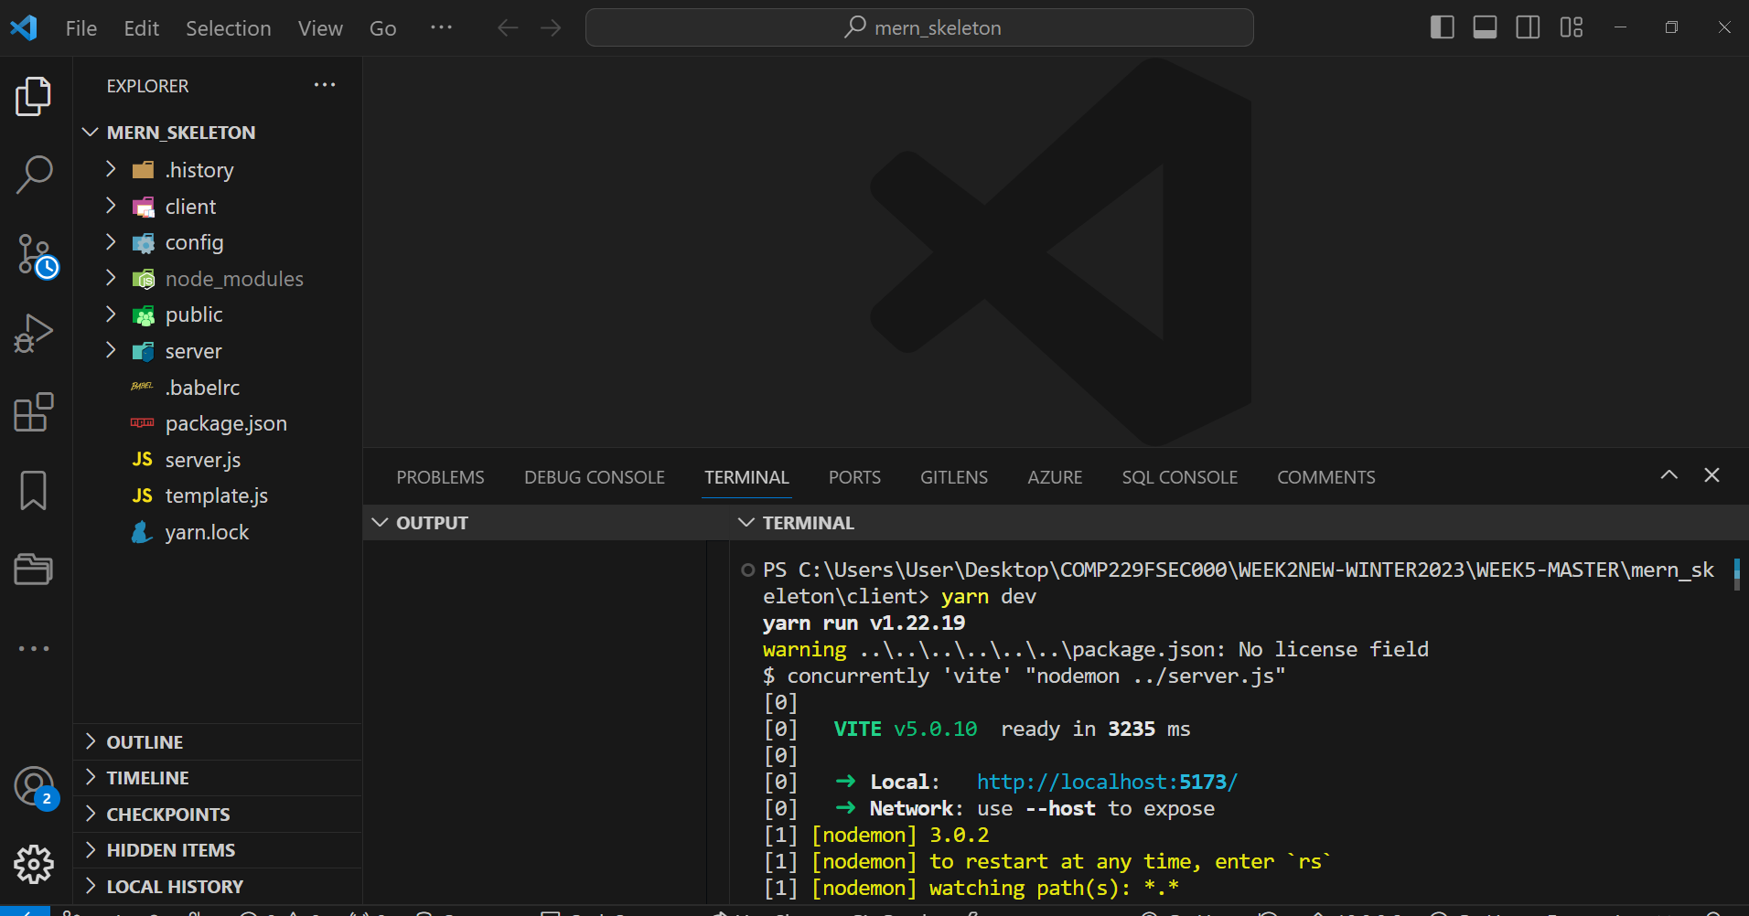
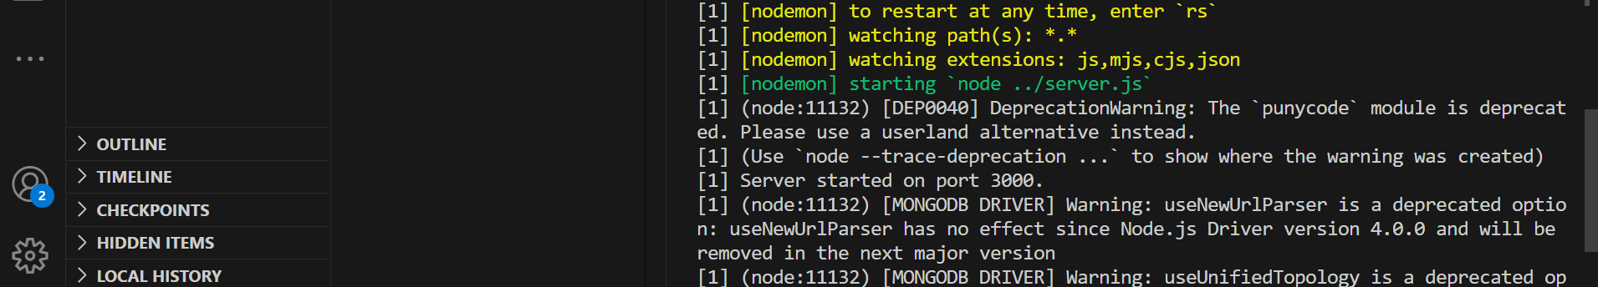
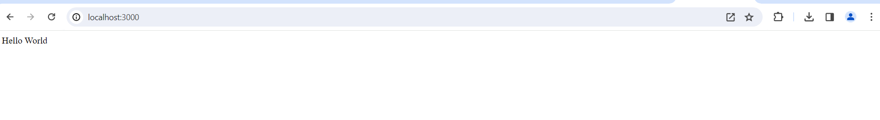
Checking the standalone backend Contd.
If you are running the code on your local machine, the root URL is http://localhost:3000/.
Using POSTMAN, we will showcase the expected behavior for five use cases so that we can check the implemented API endpoints.

Slide 4
What is an HTTP request?
​As you know, HTTP is a message-passing protocol, between two endpoints. One end will send a request, and the other will send a response.
The requester can be a browser (which is what all students have experience with), or it can be a component in an app. For example, almost every smartphone app includes a component - generically known as an HTTP client - that enables it to communicate with a web service.
HTTP defines several kinds of requests. At a minimum, a simple "get me some data" request must include the HTTP method (e.g. GET, POST, etc.), and a URL. Other kinds of requests must include other metadata.

Slide 5
Compose a request - POST​
A POST request is designed to enable the requestor to "add" a new item to the collection that is represented by the URL. Obviously, when compared to a GET request, more is required.
To compose an HTTP POST request, four settings are required:
HTTP method, POST
URL of the collection
A header that defines the content type of the data we're sending
Data (the new item)
As above, other settings may be required, but these will enable you to get started.

Slide 6
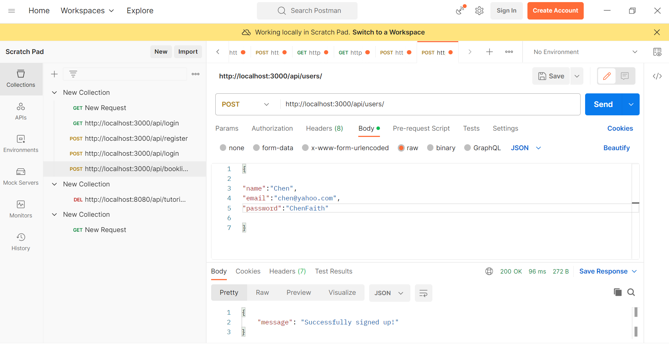
Creating a new user

Slide 7
Compose a request - GET​
To compose an HTTP GET request, two settings are required:
HTTP method, GET
URL of the collection or object
Other settings may be required (e.g. security-related info, etc.), and we'll see those in the future.

Slide 8
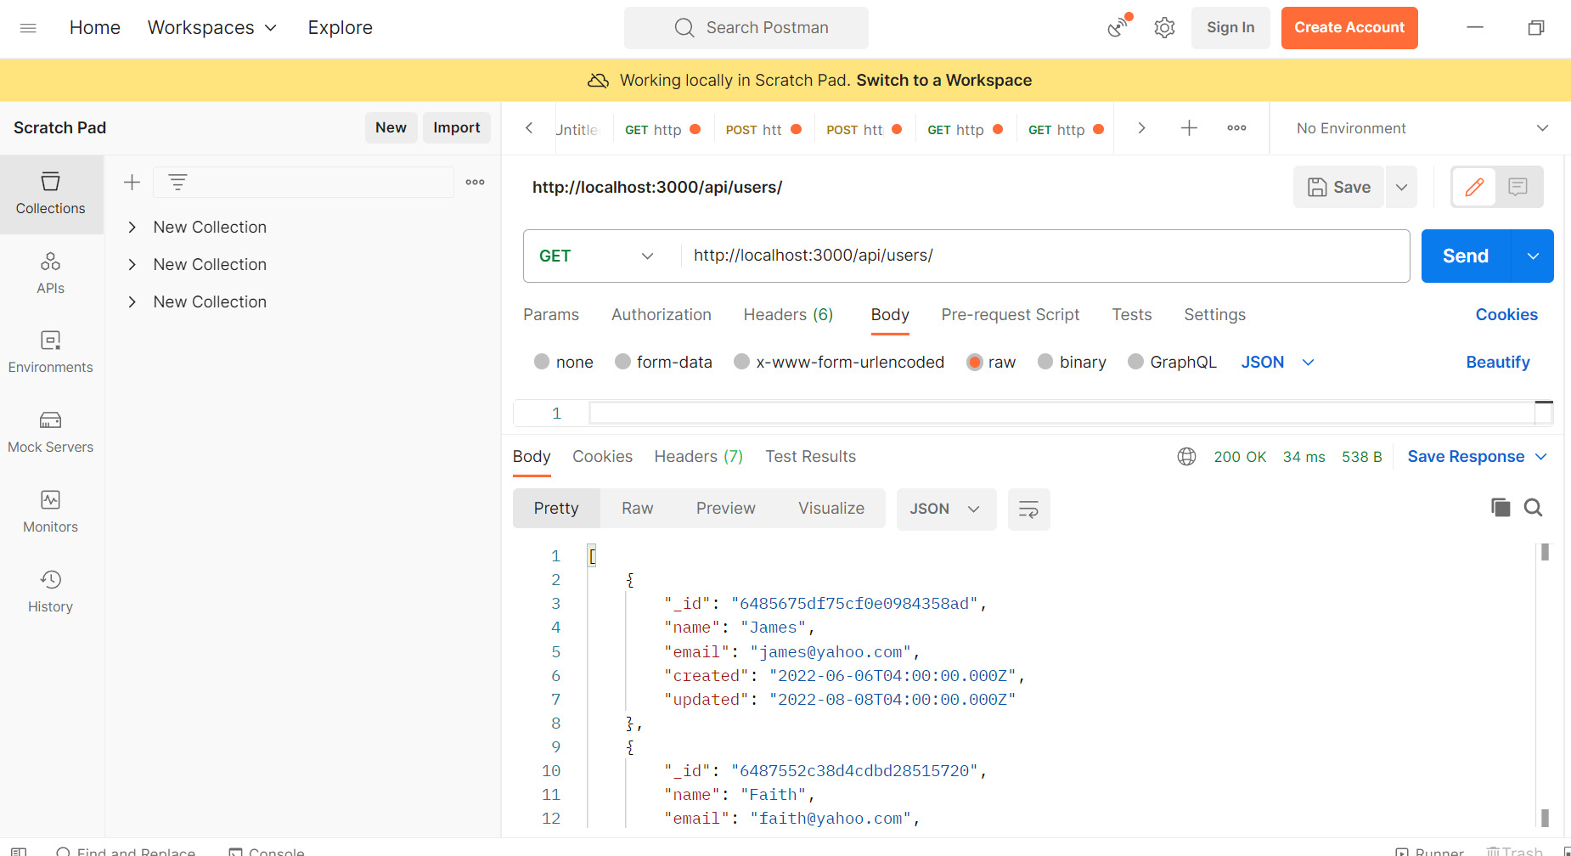
Fetching the user list
We can see whether a new user is in the database by fetching a list of all users with a GET request to /api/users.
The response should contain an array of all the user objects stored in the database:

Slide 9
Fetching the user list Contd.
Notice how the returned user objects only show the _id, name, email,and created field values, and not the salt or hashed_password values, which are also present in the actual documents stored in the database.
The request only retrieves the selected fields we specified in the Mongoose find query that we made in the list controller method.
This omission is also in place when fetching a single user.

Slide 10
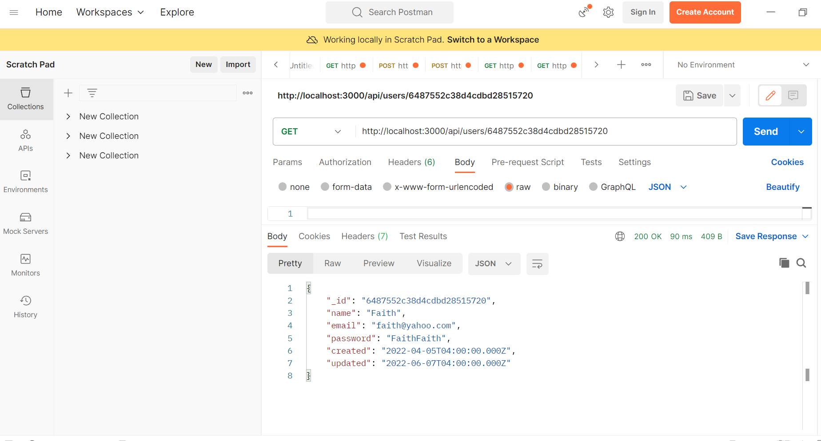
Fetching a single user
Fetching a single user by id:

Slide 11
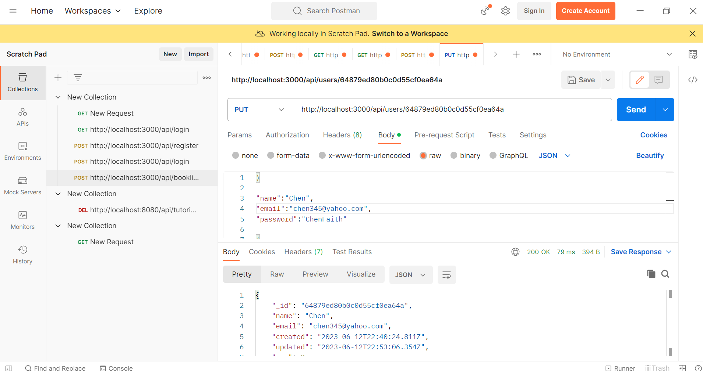
Updating a user
Updating a user using PUT

